Slide 1
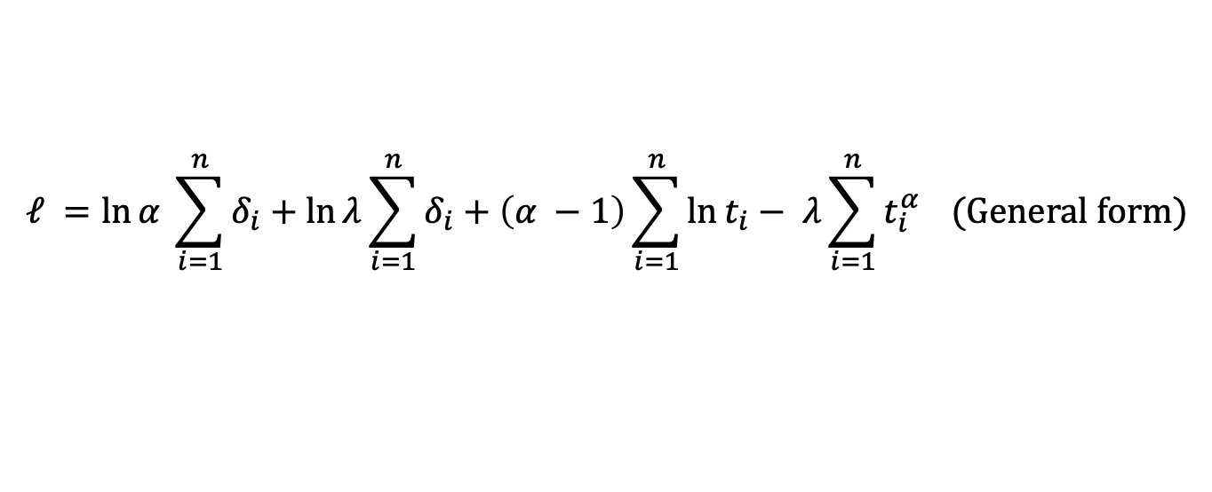

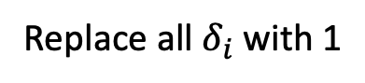
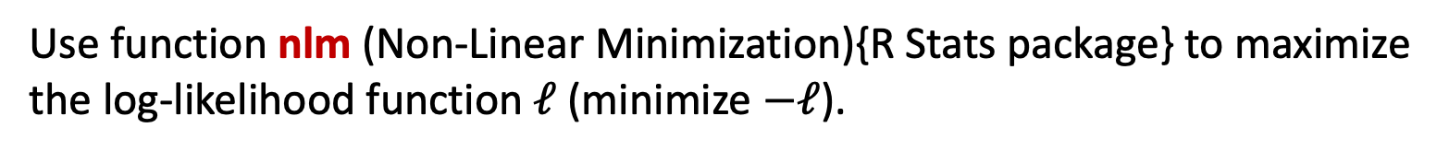
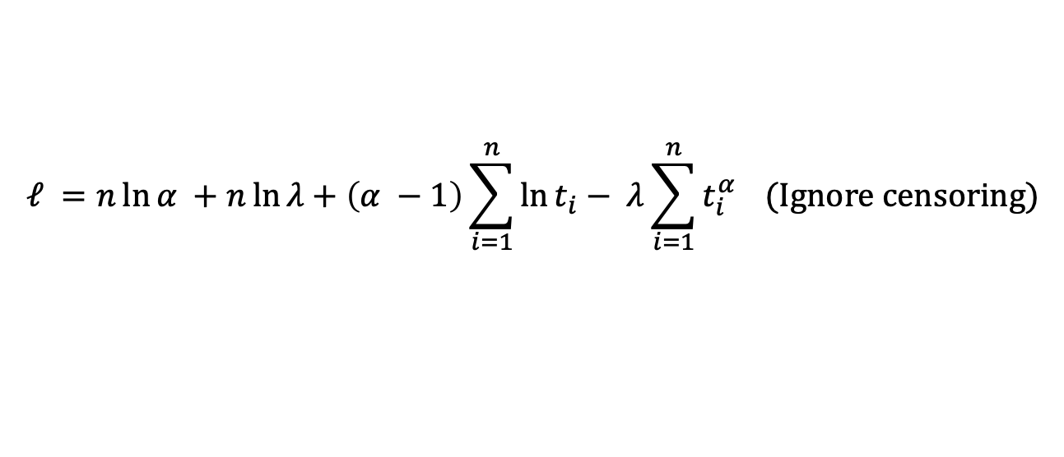
MLE of $α$ and $λ$ for Weibull distribution with $α$ and $λ$ unknown
The log-likelihood function is:
$$ℓ =\ln{α} \sum_{i=1}^{n}{δ_{i}}+\ln{λ}\sum_{i=1}^{n}{δ_{i}}+\left(α −1\right)\sum_{i=1}^{n}{\ln{t_{i}}}− λ\sum_{i=1}^{n}{t_{i}^{α}} (General form)$$
Replace all $δ_{i}$ with 1
$$ℓ =n\ln{α} +n\ln{λ}+\left(α −1\right)\sum_{i=1}^{n}{\ln{t_{i}}}− λ\sum_{i=1}^{n}{t_{i}^{α}} (Ignore censoring)$$
Use function nlm (Non-Linear Minimization){R Stats package} to maximize the log-likelihood function $ℓ$ (minimize $−ℓ$).

Slide 2
MLE of $α$ and $λ$ for Weibull distribution with $α$ and $λ$ unknown
X-axis: Time
Y-axis: Survival rate
+: symbol of censored observations
Does reflect censoring

Slide 3
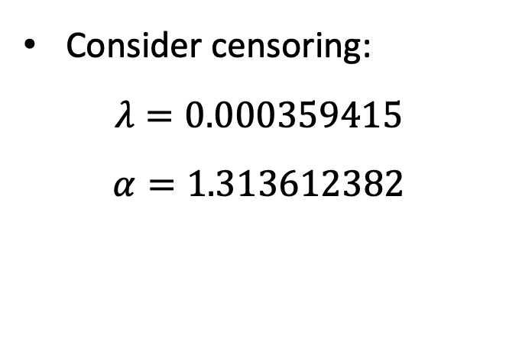
MLE of $α$ and $λ$ for Weibull distribution with $α$ and $λ$ unknown
Consider censoring:
$$λ=0.000359415$$
$$α=1.313612382$$

Slide 4
MLE of $α$ and $λ$ for Weibull distribution with $α$ and $λ$ unknown
Consider censoring:
$$λ=0.000359415$$
$$α=1.313612382$$

Slide 5
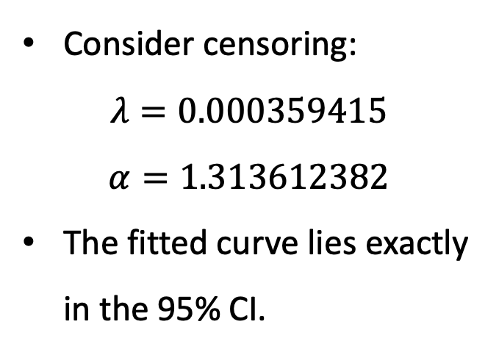
MLE of $α$ and $λ$ for Weibull distribution with $α$ and $λ$ unknown
Consider censoring:
$$λ=0.000359415$$
$$α=1.313612382$$
The fitted curve lies exactly in the 95% CI.

Slide 6
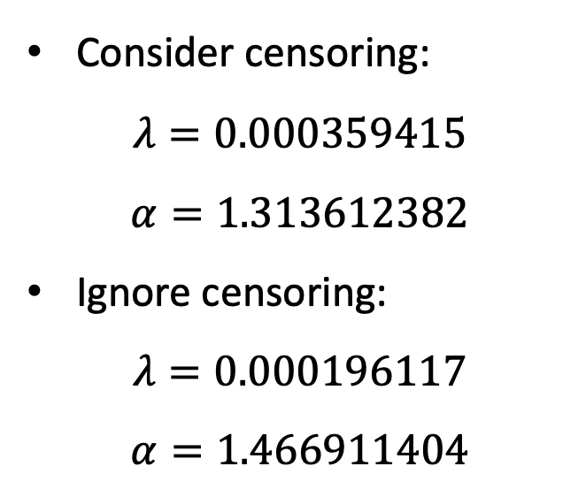
MLE of $α$ and $λ$ for Weibull distribution with $α$ and $λ$ unknown
Consider censoring:
$$λ=0.000359415$$
$$α=1.313612382$$
Ignore censoring:
$$λ=0.000196117$$
$$α=1.466911404$$

Slide 7
MLE of $α$ and $λ$ for Weibull distribution with $α$ and $λ$ unknown
Consider censoring:
The censored curve fits the Kaplan-Meier curve.
Ignore censoring:
The uncensored curve fits the empirical distribution function of survival time (Vertical flip).

